Slide 1
QA Hobby Project
Devin Patel

Slide 2
What it is
This project is for storing data for a bicycle event
It will be able to
Create
Add
Update
Delete
Riders from a database using a front-end web page. You will be able to either see all riders or search by team name.

Slide 3
Documentation and Workflow management
Documents can be found that include
MoSCow
Risk Assessment
ERD
UML
Jira Kanban board or User stories and workflow management.
https://devinpatel.atlassian.net/jira/software/projects/QHP/boards/4

Slide 4
What was used?
Java and Spring for backend and connecting to database
SQL and H2 for databases for live and testing periods
HTML, JS, CSS (from an external library - BootStrap) for frontend, functionality, styling
JUnit for testing

Slide 5
Functionality
I will now perform a quick demonstration of the code in action (can be found at: https://github.com/D-Pats/QA-Hobby-Project)

Slide 6
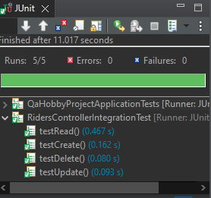
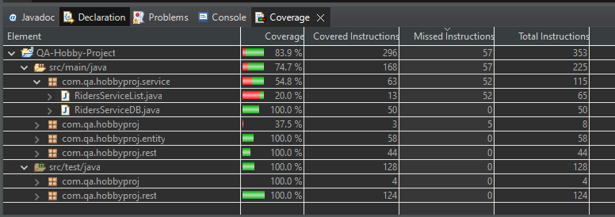
Coverage and Testing
As shown here Coverage has reached 83.9% as well as tests on the CRUD functionality all passing:
This can be increased by removing the ServiceList.Java file as it is not required after testing.

Slide 7
Reflection
Upon reflection I could have learnt SonarQube for smells and included in my work, I could have also completed mockito testing however I was not able to do so.
I am happy with full CRUD and the additional feature of searching by team name.
I believe I have improved on my previous project and also correctly done my user stories/Jira workflow board.

